Slide 1

Predicting Traffic Data

Slide 2
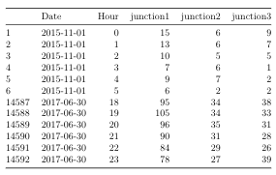
Data Set
Data from 3 Junctions
https://www.kaggle.com/vetrirah/ml-iot

Slide 3
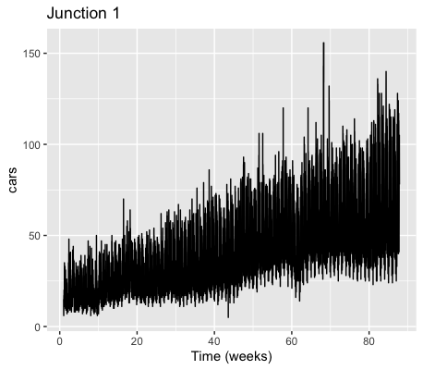
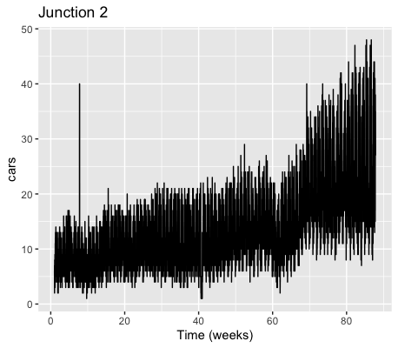
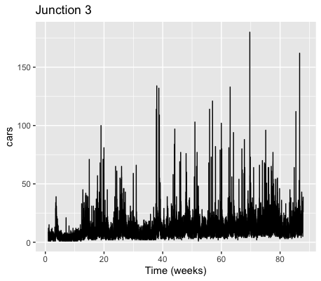

Slide 4
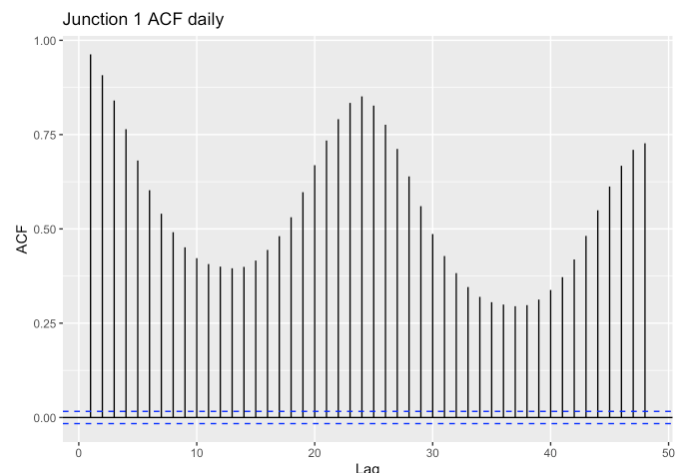
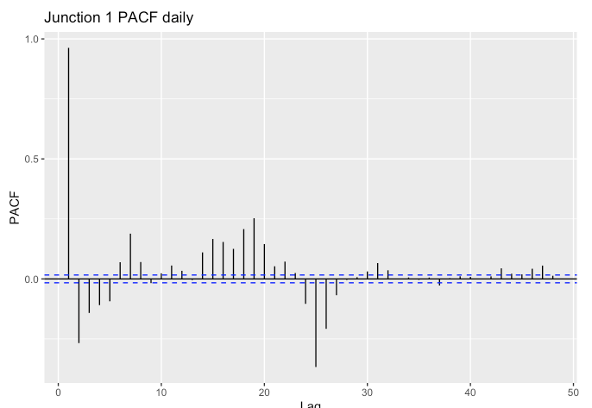

Slide 5
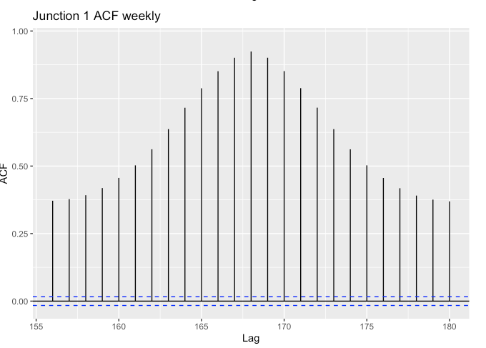
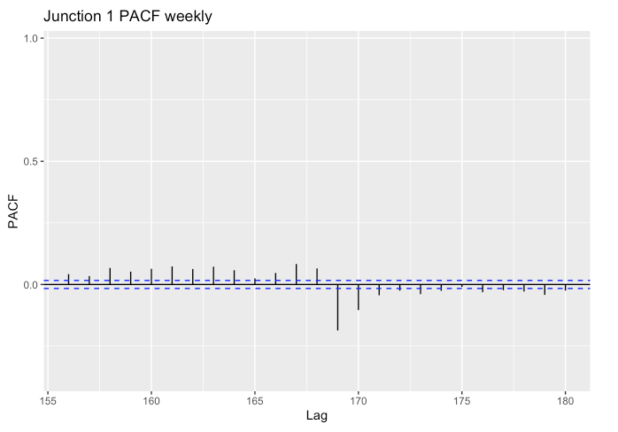

Slide 6
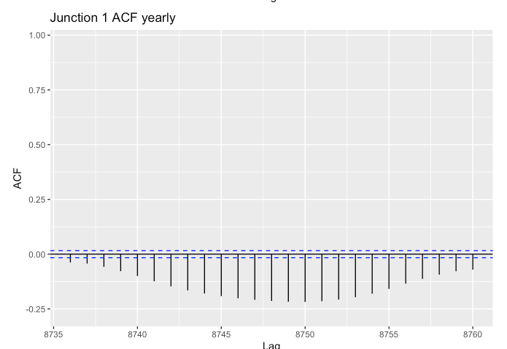
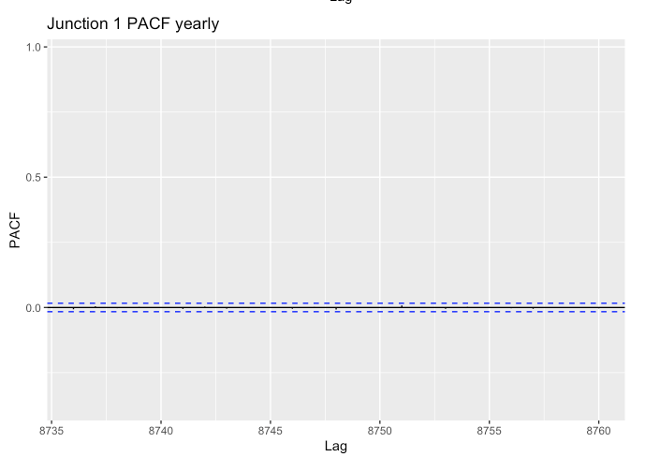

Slide 7
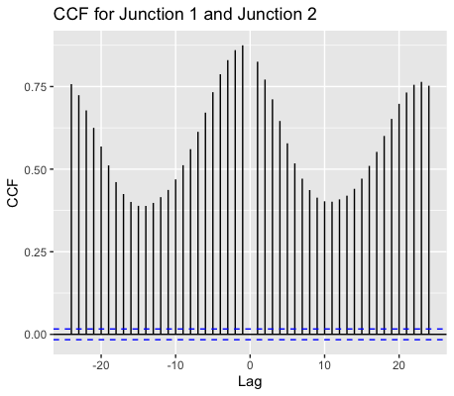

Slide 8
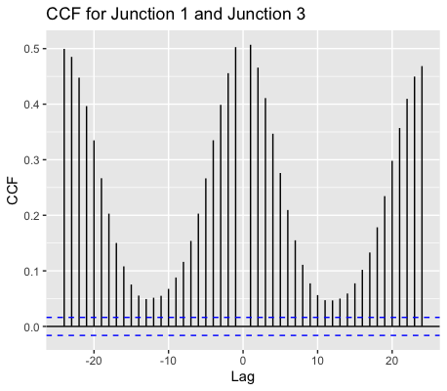
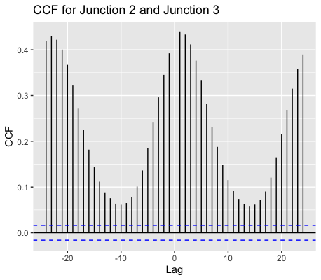

Slide 9
MANAGING THE DATA

Slide 10
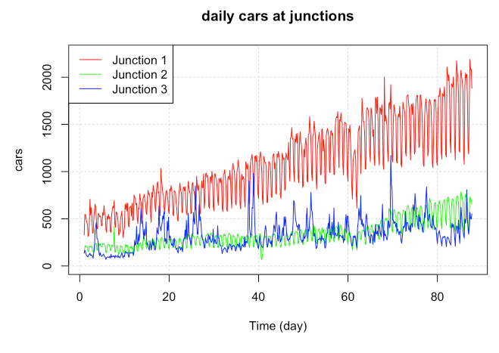

Slide 11
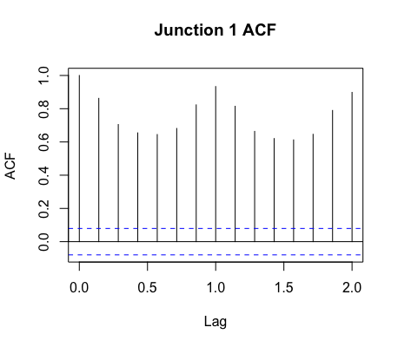
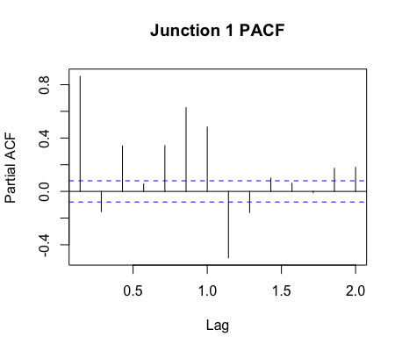

Slide 12
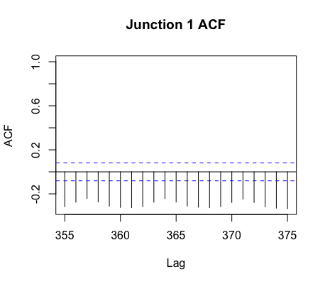
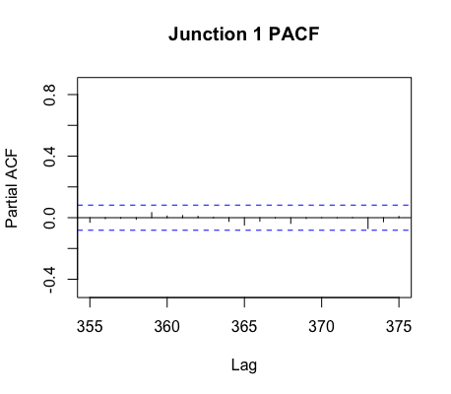

Slide 13
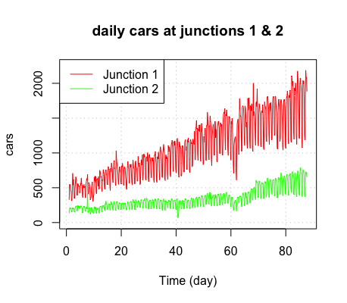
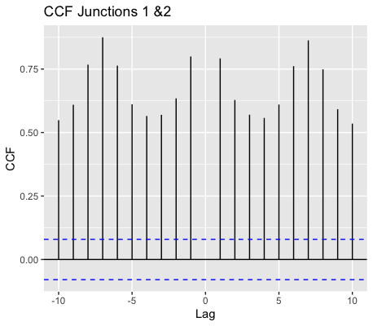

Slide 14
Model Building
& Evaluation

Slide 15
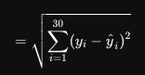
Data Evaluation
Test data - June 2017 (30 days)
Train data - rest
AIC
Root Mean Square Error (rmse)

Slide 16
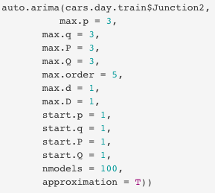
auto.arima()

Slide 17
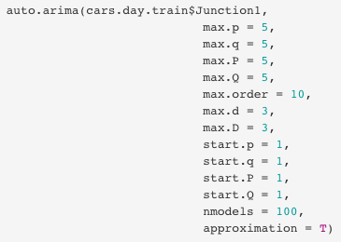
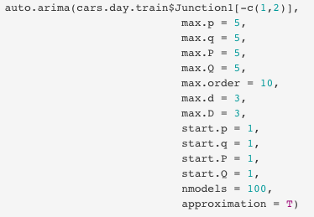
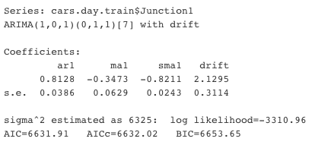
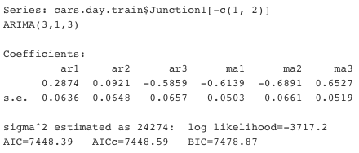
WARNING

Slide 18
Modelling Junction 1

Slide 19
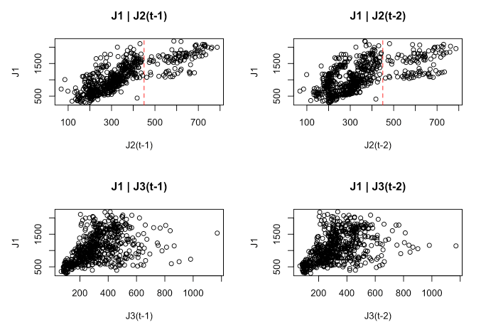

Slide 20
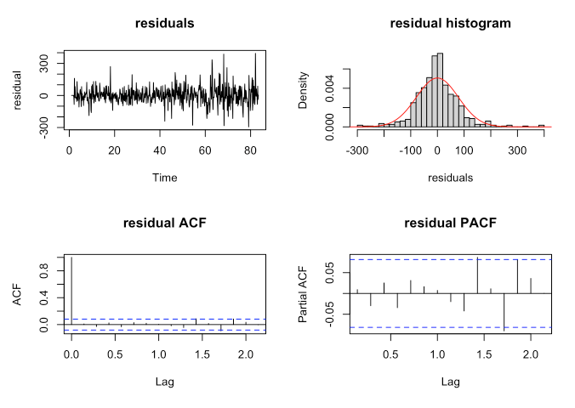
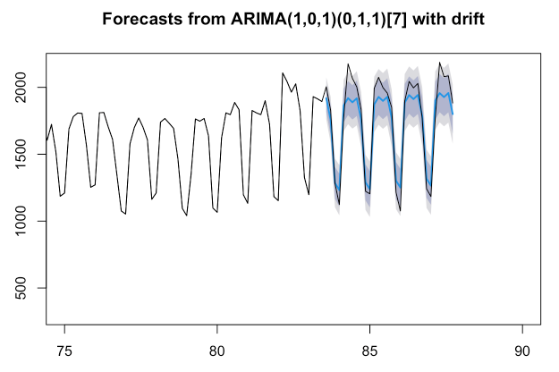
Model 1

Slide 21
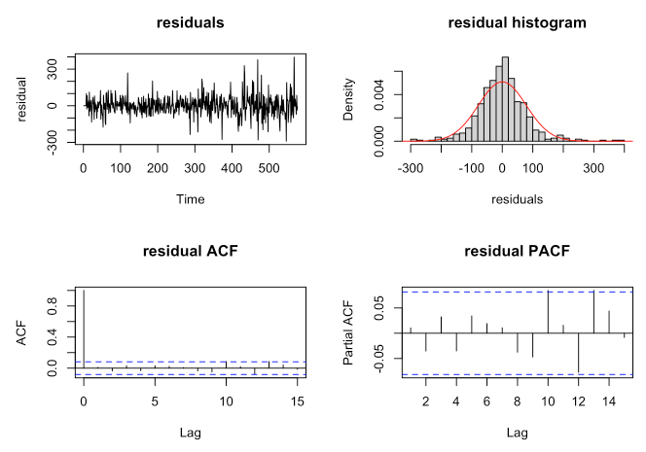
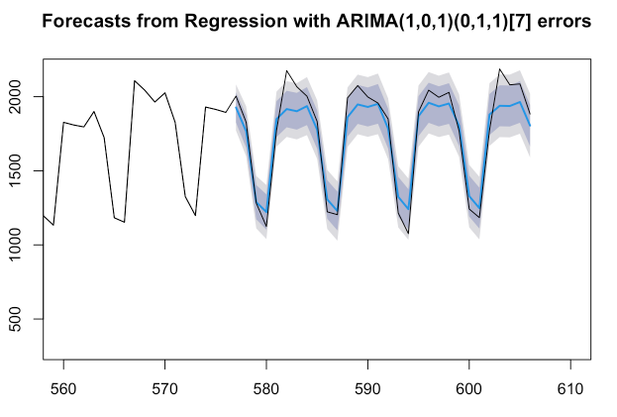
Model 2

Slide 22
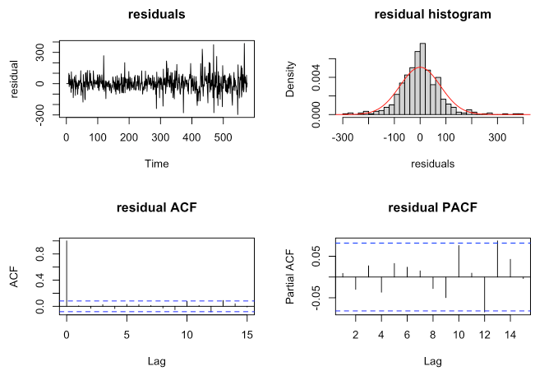
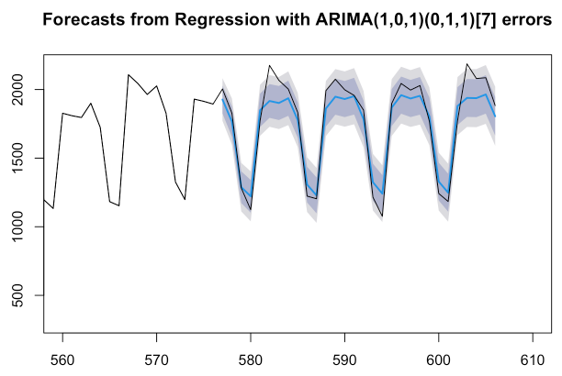
Model 3

Slide 23
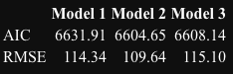
Selection

Slide 24
Modelling Junction 2

Slide 25
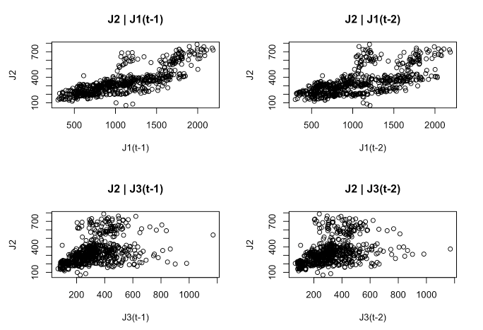

Slide 26
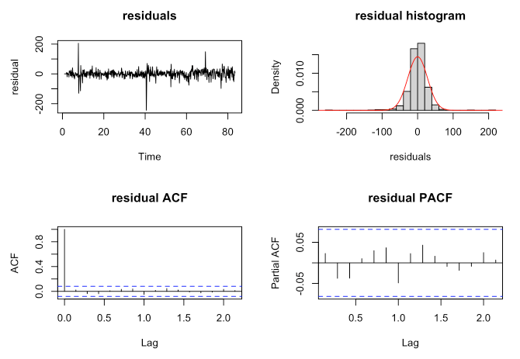
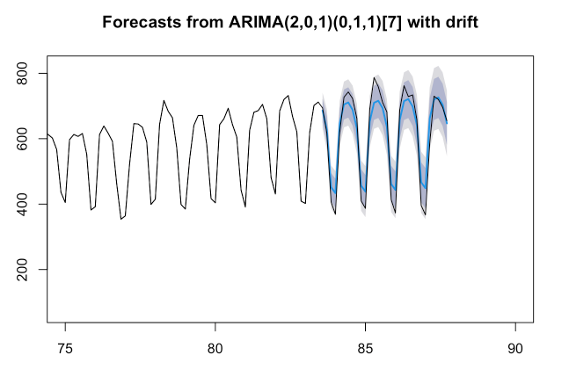
Model 1

Slide 27
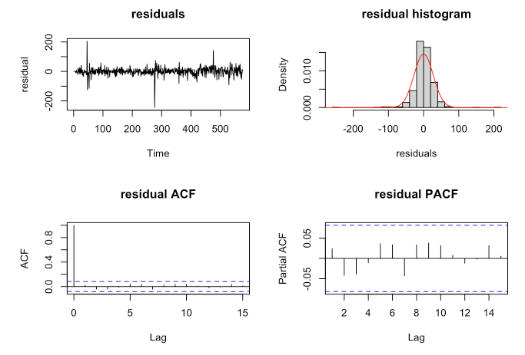
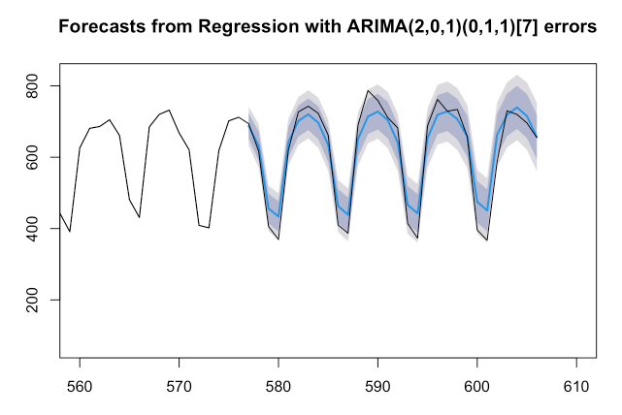
Model 2

Slide 28
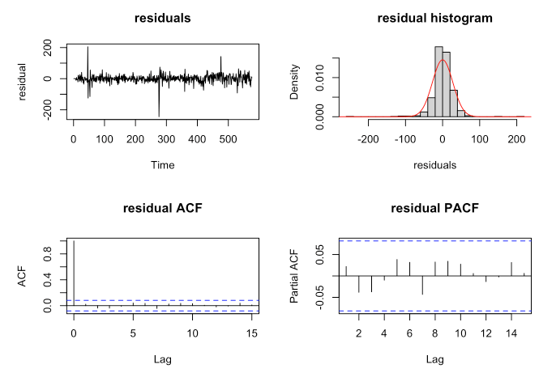
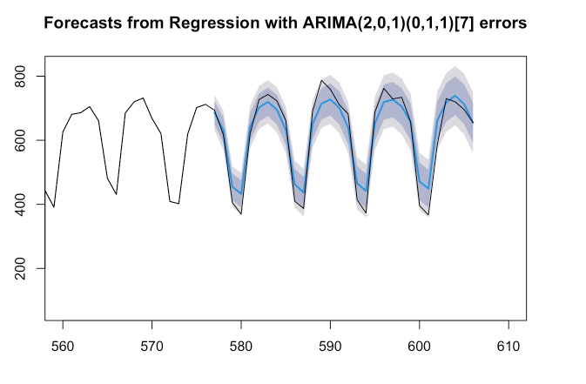
Model 3

Slide 29
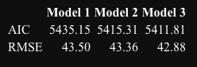
Model Selection

Slide 30
Modelling Junction 3

Slide 31
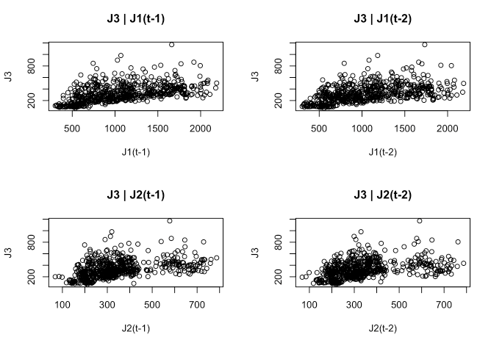

Slide 32
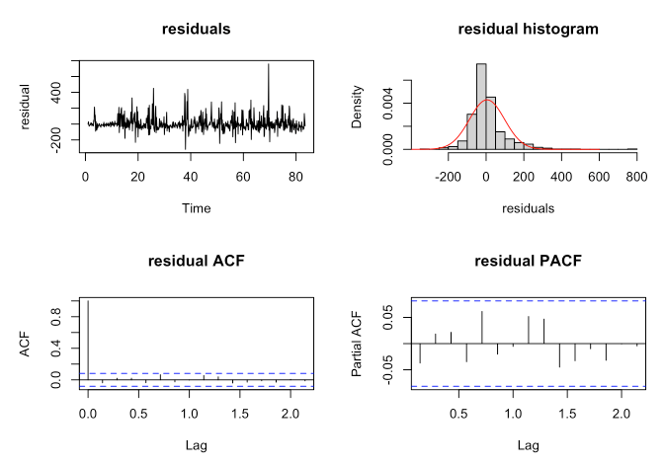
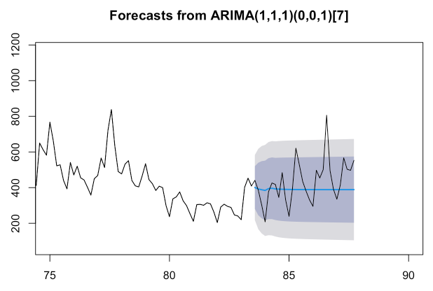
Model 1

Slide 33
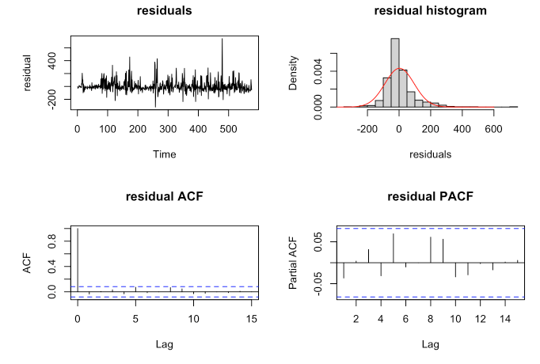
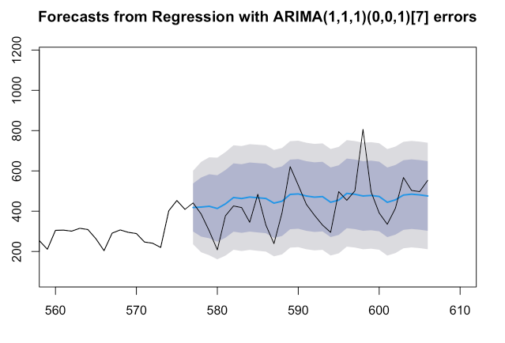
Model 2

Slide 34
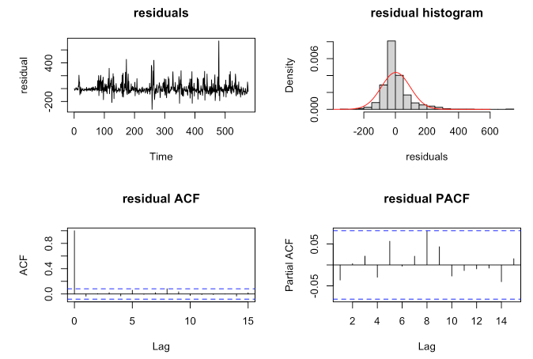
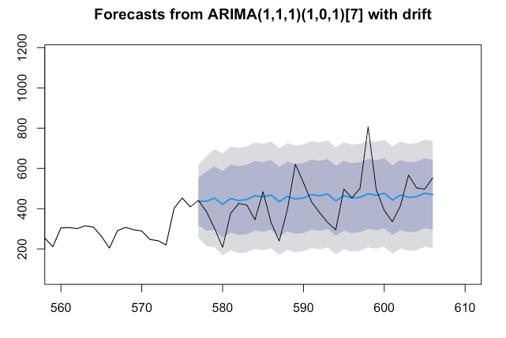
Model 3

Slide 35
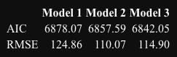
Model Selection

Slide 36
Residual Comparison

Slide 37

Model 1 (1,0,1)(0,1,1)[7] + J2(t-1)
Model 2 (2,0,1)(0,1,1)[7] + J1(t-1) +J3(t-1)

Slide 38

Model 1 (1,0,1)(0,1,1)[7] + J2(t-1)
Model 3 (1,1,1)(0,0,1)[7] + J1(t-1) +J1(t-2) + J2(t-1) + J2(t-2)

Slide 39

Model 2 (2,0,1)(0,1,1)[7] + J1(t-1) +J3(t-1)
Model 3 (1,1,1)(0,0,1)[7] + J1(t-1) +J1(t-2) + J2(t-1) + J2(t-2)

Slide 40
CONCLUSION
SARIMA models can accurately predict data
Residuals are uncorrelated
MARIMA unnecessary

Slide 41
SPECIAL MENTIONS
Log transform
RMSE ~ 10X greater
TBATS
Exponential Smoothing State Space Model With Box-Cox Transformation, ARMA Errors, Trend and Seasonal Components¹
RMSE ~ 50% greater
1 https://www.rdocumentation.org/packages/forecast/versions/8.12/topics/tbats

Slide 42

END

